Slide 1
Bio Art: The Merging of Science and Art
ASA Workshop
with Hillary Broder

Slide 2
What is Bio Art?
So much of art is inspired by nature and science. Bio Art is a term that identifies that science can be a catalyst and inspiration for art projects in all mediums, photography, drawing and painting, collage, etc. Even making art from biologic materials such as bacteria and microscopic images.

Slide 3
RVC Ed Foundation Grant
-RVC Ed Foundation Grant was used to supplement and enhance my Bio Art Curriculum already in place.
-Celestron Microscopes: Handheld and Tetra View
-Specimens: Skull, Insects in Resin, Minerals, Slides.

Slide 4
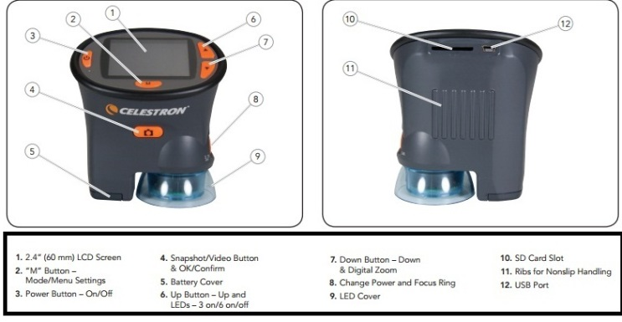
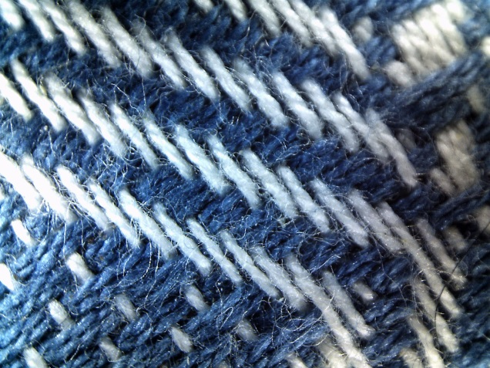
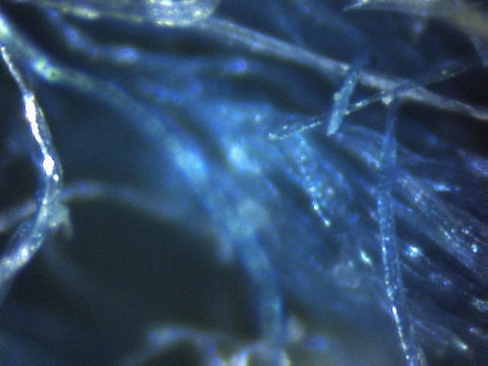
Microscopic Images
What is a microscope?
What is a microscopic image?

Slide 5
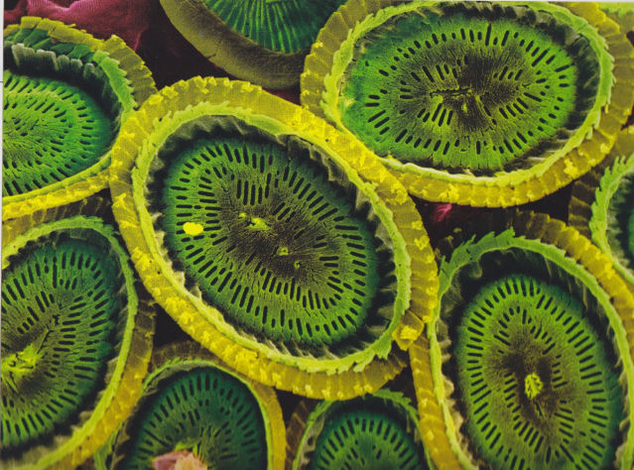
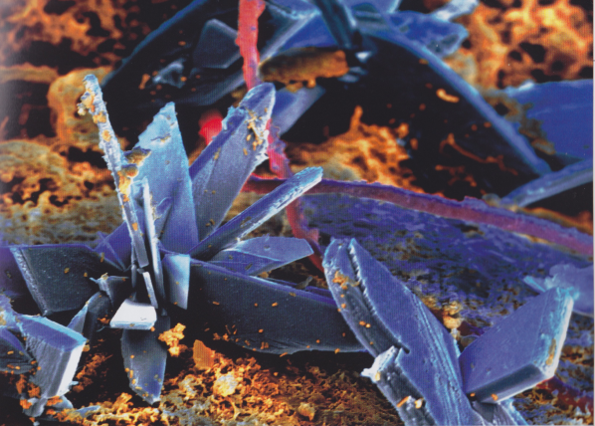
Microscopic Images

Slide 6
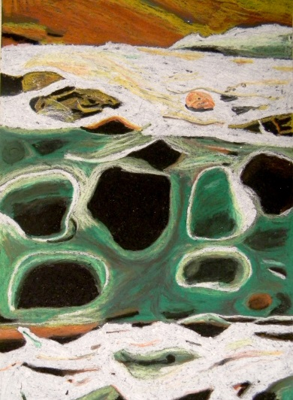
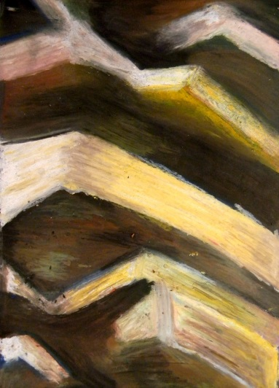
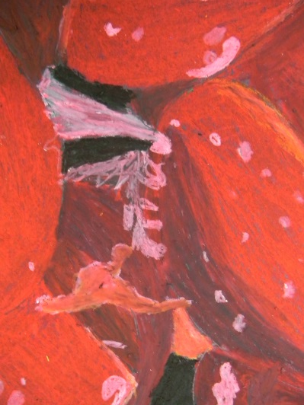
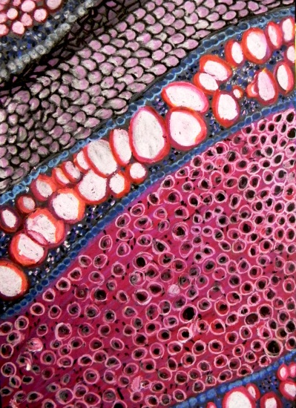
Microscopic Images: Student Work

Slide 7
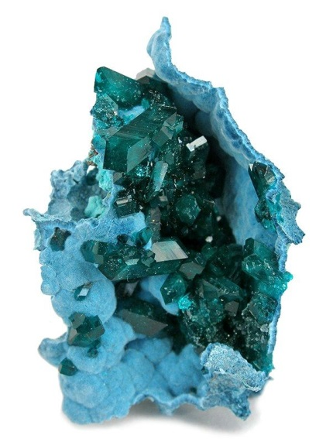
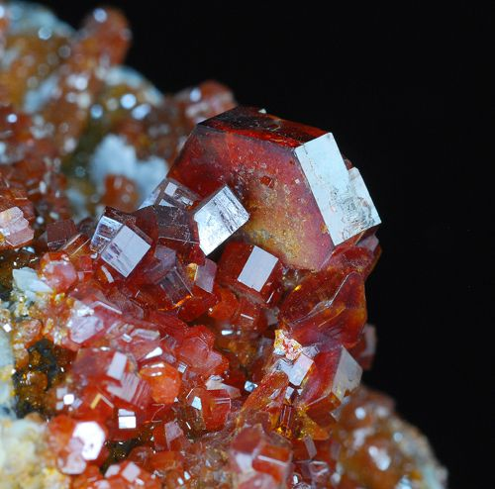
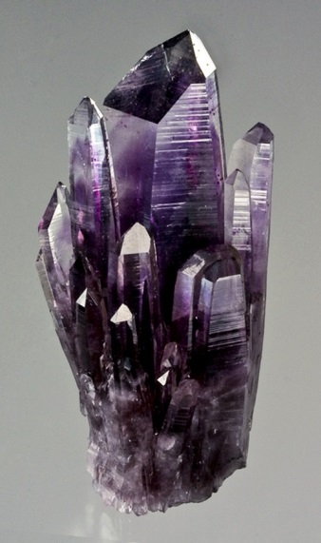
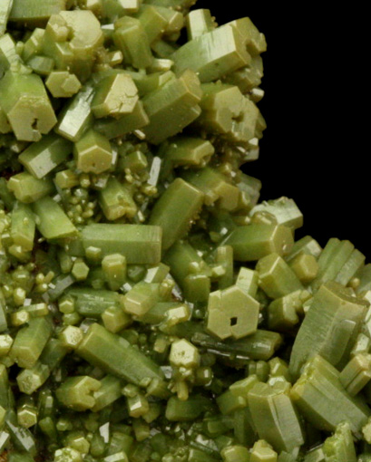
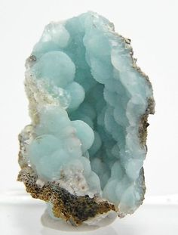
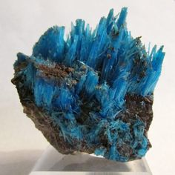
Crystals and Minerals

Slide 8
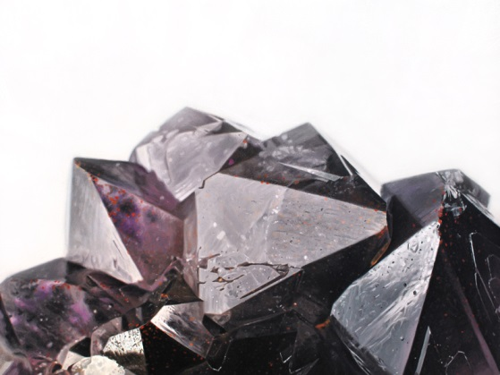
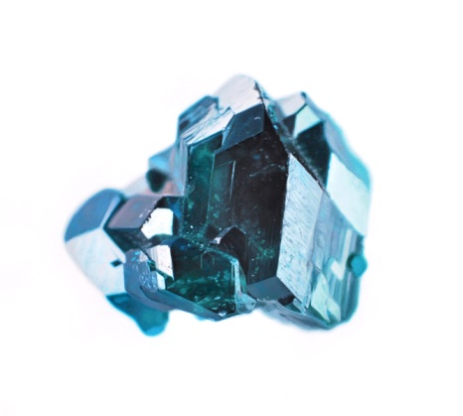
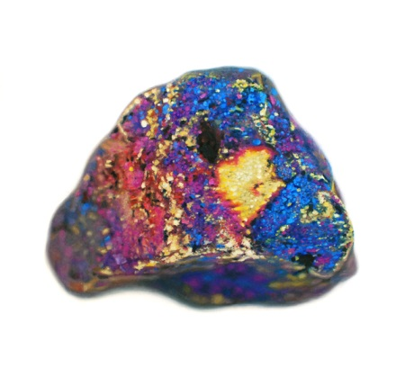
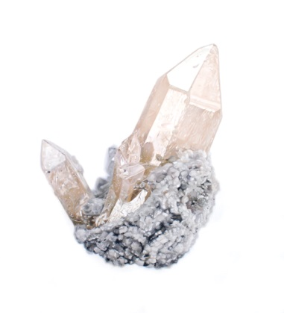
Crystals and Minerals: Paintings by Carly Waito

Slide 9
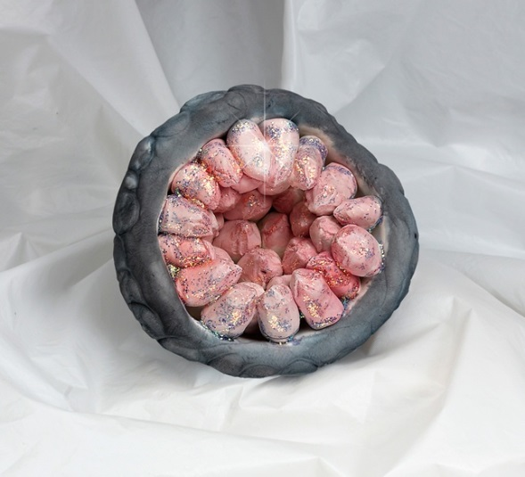
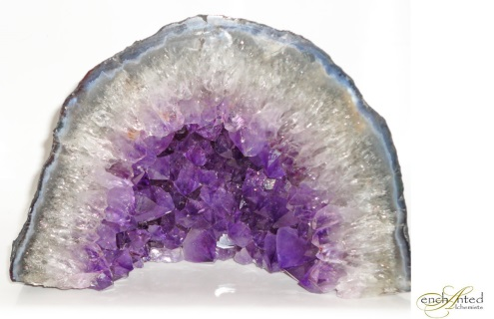
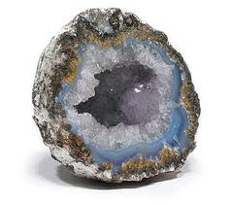
Crystals and Minerals: Geode Sculptures
1)Pinch pot for outside Geode shell
2)Create little crystal points
3)Stick point to rounded rock shell
4)Paint with Watercolor
5)Add Glitter to inside crystals

Slide 10
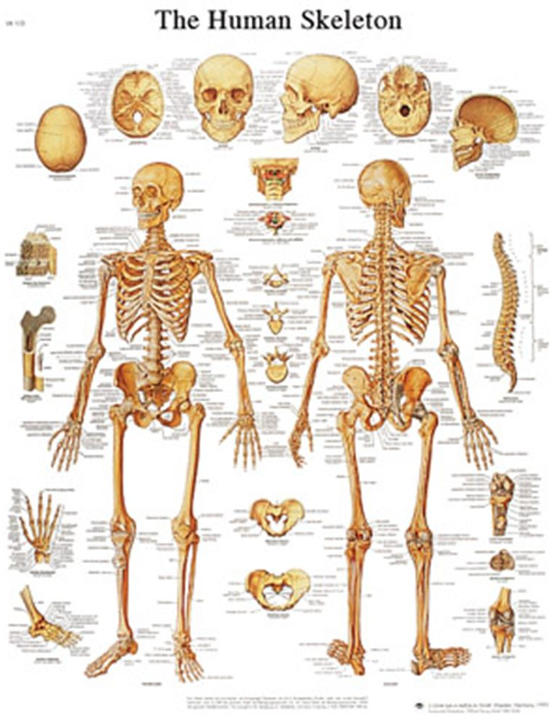
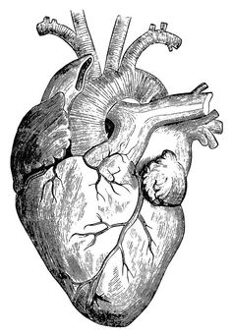
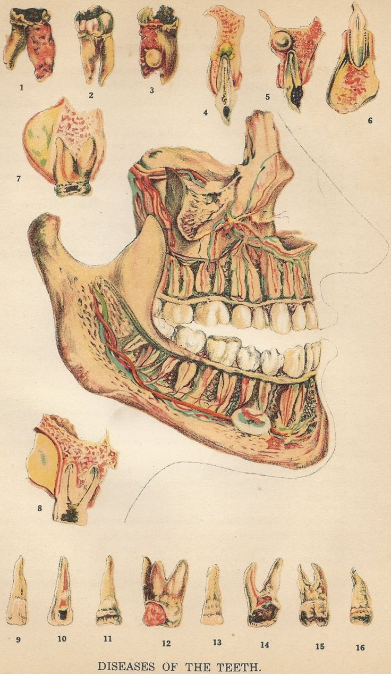
Anatomy

Slide 11
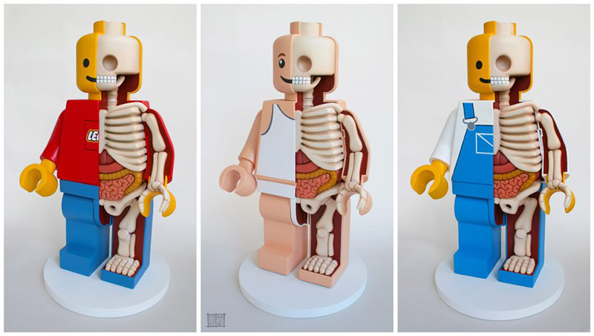
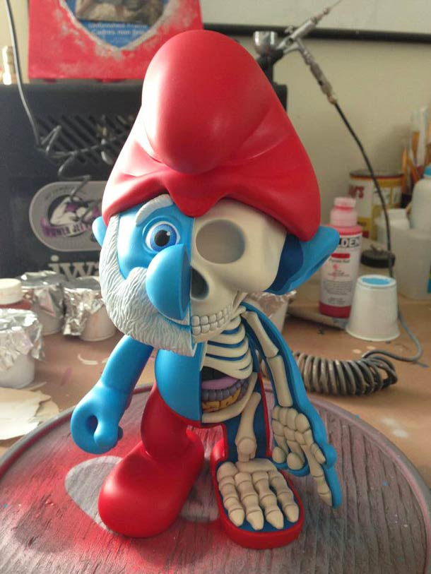
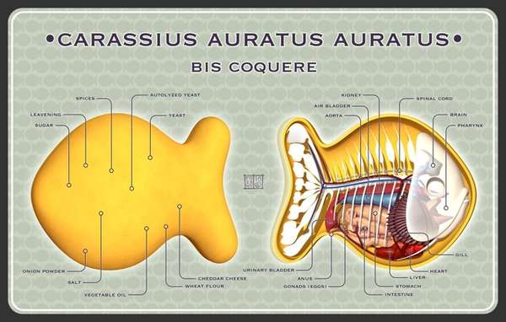
Invented Anatomy: Jason Freeny

Slide 12
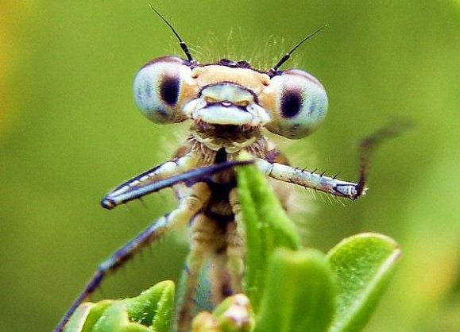
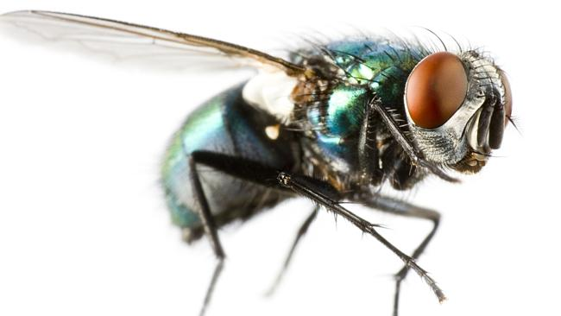
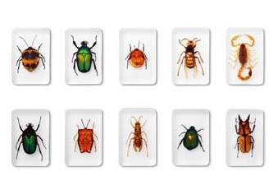
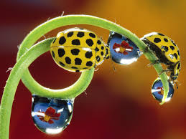
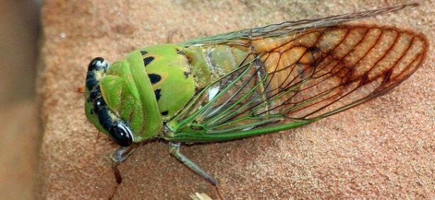
Insects: Specimens as Art, Art used as a tool for Investigation

Slide 13
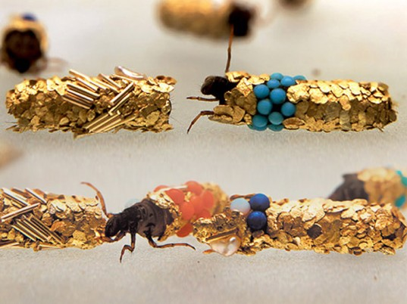
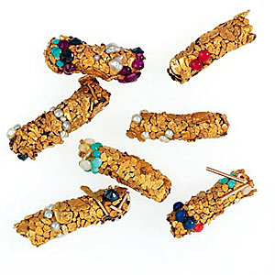
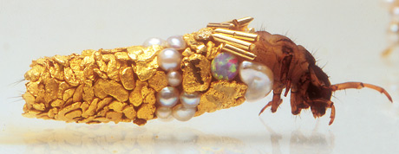
Crystals and Minerals: Caddis Fly Jewelry
https://www.youtube.com/watch?v=jID1_GwxiE0

Slide 14
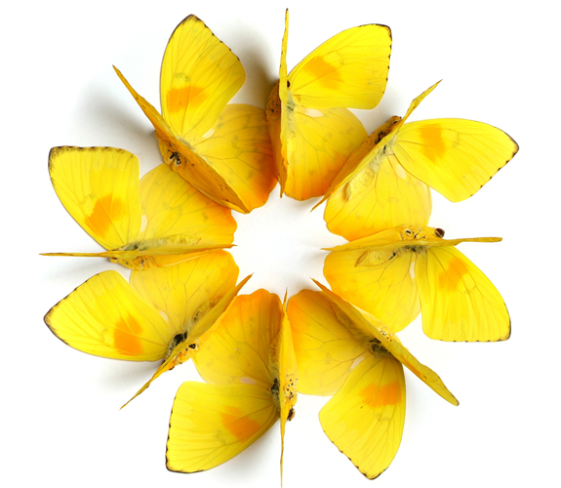
Insects: Christopher Marley
Christopher Marley is an artist who creates artwork with real insects. Originally Marley had a phobia of insects but then found himself drawn to the framed bugs being sold at fairs. The safety of the insects being hidden behind glass allowed Marley to take a closer look.
Upon closer examination, Marley found himself fascinated and impressed by the insects’ intricate details, tiny mechanisms/ parts and bright colors.
Marley opened up the frames he bought and rearranged the insects into patterns and designs that he found interesting and appealing to him as an artist.
Marley says he wants his artwork to evoke feelings of structure and refinement, rather than slithering or clicking (The usual response to insects)

Slide 15
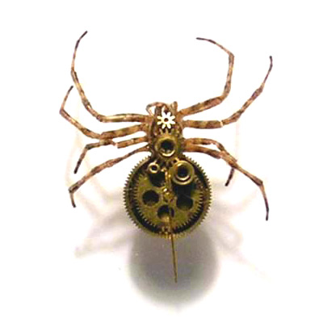
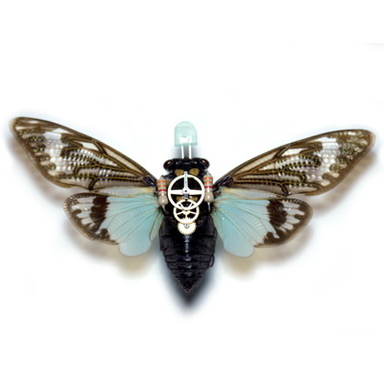
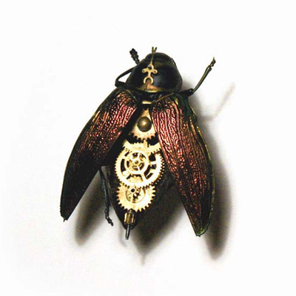
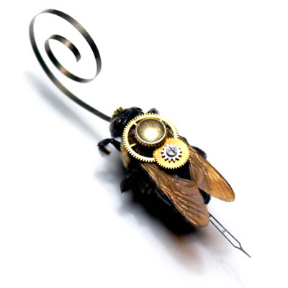
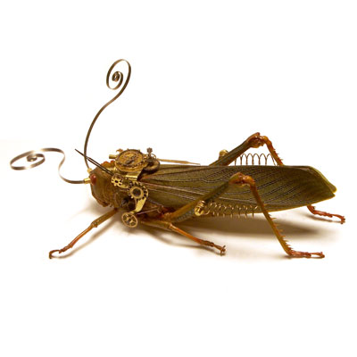
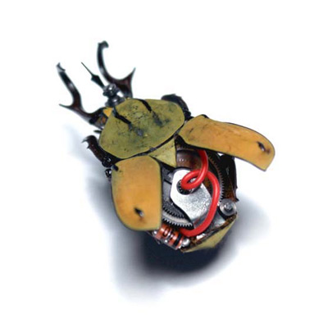
Insects: Mike Libby
“One day I found a dead intact beetle. I then located an old wristwatch, thinking of how the beetle also operated and looked like a little mechanical device and so decided to combine the two. After some time dissecting the beetle and outfitting it with watch parts and gears, I had a nice little sculpture.”
Mike Libby is a RISD Graduate from Maine is a working artist who shows his insect art in galleries and museums across the Country.

Slide 16
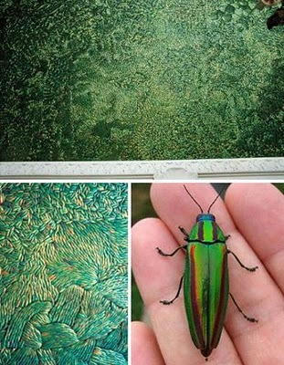
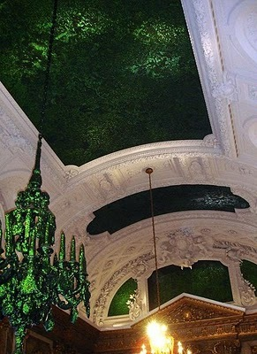
Insects: Jan Fabre
Entitled "Heaven of Delight", Belgian artist Jan Fabre has created "murals" out of Jewel Beetle wings.
Over 1.5 million beetle wings have been used to cover the ceiling panels and chandelier in the Belgian Royal Palace. Although he had several full-time helpers, this work still took months to install!
The wings of these beetles capture, reflect and transform light.
These beetle elytra come as a by-product of the Thai food industry. The rather large beetles are used as food, and the wings are thrown away!

Slide 17
Insects: Facts
Many of the insects are thought to be pests by humans. But there are hundreds of insects that help the human race in various ways.
Insects are necessary to pollinate flowering plants, without the active help of insects thousands of plant varieties would have become extinct.
Insects produce substances such as wax, honey and silk which are then used by humans in a large number of ways and for direct consumption.
The ecosystem heavily relies on insects for decomposition, nutrient and energy recycling, soil aeration, and pollination.
Insects are helpful with collecting and recycling garbage wastes.
Dead organisms are broken down by insects and this assists in the formation of new life.

Slide 18
Insects: Project Description
Practice Drawing Insects using simplified shapes then adding details
Choose insect of choice
Research component
Draw several studies of insect
Create final drawing
Print research single spaced 10pt. Type
Tea Stain research
Trace final drawing of insect onto tea stained paper
Use colored pencils to draw insect realistically using color theory

Slide 19
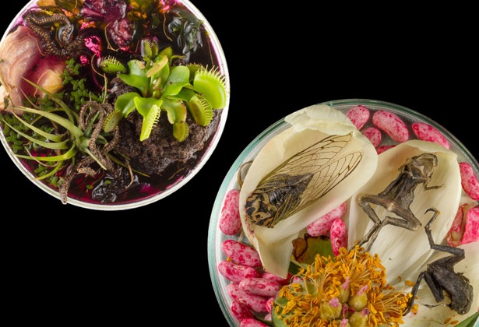
Petri Dish Still Lifes

Slide 20
HillaryBroder.com

